Slide 1
REST/Webhook/websocket/ gRPS
Name

Slide 2
Comparison Table
Technology | Category | How Communication Works | Connection Type | Data Format | Performance | Real-Time Capability | Complexity | Best Use Case
Webhook | Event-driven integration | Server automatically sends data when an event happens | Short-lived HTTP request | JSON / XML | Fast | Near real-time | Low | Payment alerts, CI/CD triggers
Flask API | Backend framework | Client sends HTTP request to server | Stateless HTTP | JSON | Medium | No | Low | Small APIs and prototypes
FastAPI | Backend framework | Client request → async processing → response | Stateless HTTP | JSON | Very Fast | Limited | Medium | High-performance APIs
REST | API architecture | Resource-based requests using HTTP methods | Stateless | JSON / XML | Fast | No | Low | Standard web APIs
SOAP | Protocol | Strict XML messaging with predefined contract | Stateful or stateless | XML | Slow | No | High | Banking & enterprise systems
GraphQL | API query language | Client specifies exactly what data it needs | Stateless HTTP | JSON | Fast | No | Medium | Complex frontend data needs
gRPC | RPC framework | Client calls remote functions on server | Persistent HTTP/2 | Protocol Buffers (binary) | Very Fast | Yes (streaming) | Medium | Microservices communication
WebSocket | Real-time protocol | Persistent bidirectional communication | Long-lived TCP | JSON / Binary | Very Fast | Yes | Medium | Chat, live dashboards

Slide 3
System-Design Feature Comparison
Feature | REST | GraphQL | gRPC | WebSocket | Webhook
Communication | Request–Response | Query-based | Remote Procedure Call | Bidirectional stream | Event-based push
Connection Duration | Short | Short | Persistent (HTTP/2) | Persistent | Short
Data Efficiency | Medium | High | Very High | High | Medium
Payload Format | JSON | JSON | Binary | JSON/Binary | JSON
Latency | Medium | Medium | Very Low | Very Low | Low
Streaming | No | Limited | Yes | Yes | No
Scalability | High | High | Very High | Medium | High
Real-time | No | No | Partial | Yes | Yes (event trigger)

Slide 4
REST API Architecture
Client (Browser / Mobile App)
|
| HTTP Request
v
REST API Server
|
v
Application Logic
|
v
Database
Characteristics
Stateless architecture
Uses HTTP methods (GET, POST, PUT, DELETE)
Lightweight JSON responses
Dominant API architecture today
Limitations
Multiple requests needed for complex data
Over-fetching or under-fetching data
Example
Mobile app,cloud app,web app,weather report

Slide 5
GraphQL
Frontend
|
GraphQL Query
|
GraphQL Server
|
Multiple Data Sources
(DB + Microservices)
Characteristics
Client controls the data structure
Reduces multiple API calls
Single endpoint for queries
Limitations
More complex server logic
Harder caching
Example
Social media feed,e-commerce product listing

Slide 6
SOAP
Client
|
SOAP Request (XML)
|
Application Server
|
Database
Characteristics
XML-based messaging
Strict contracts (WSDL)
High security standards
Limitations
Large payload size
Complex implementation
Slower performance
Example
Banking,Retail and Enterprise systems

Slide 7
WebSocket Architecture
Client
|
| Persistent Connection
| <----------------------------->
|
WebSocket Server
|
Real-time Data Stream
Characteristics
Full duplex communication
Single long-lived connection
Bidirectional communication
Used in live systems
Persistent connection
Examples
Chat applications
Stock trading dashboards
Online gaming

Slide 8
Webhook Architecture
Event Source (GitHub / Payment Gateway)
|
| Event Trigger
v
Webhook Endpoint (Your API)
|
v
Process Event
Characteristics
No polling required
Automatic event notification
Lightweight integration
Example
Payment Notification System
Singnature verififcation
Handling duplicates
GitHub

Slide 9
gRPC Architecture
Client Service
|
| RPC Call
| (HTTP/2 + Protocol Buffers)
v
gRPC Server
|
Service Implementation
|
Database / Microservice
Characteristics
Binary data format (Protocol Buffers)
Extremely low latency
Built for microservices communication
Limitations
Harder debugging
Less browser compatibility
Example
Microservice,edge computing,IoT

Slide 10
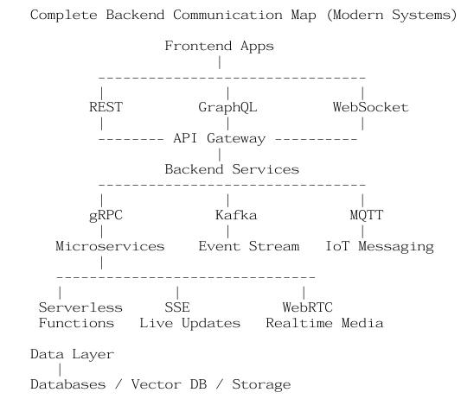
Backend Communication Map

Slide 11
Conclusion
FEATURES | API
Standard API | REST
Flexible data fetching | GraphQL
Microservices communication | gRPC
Real-time communication | WebSocket
Event notification | Webhook
IoT messaging | MQTT
Standard API | REST
Flexible data fetching | GraphQL
Microservices communication | gRPC

